Slide 1

CREDIT CARD FRAUD DETECTION:
Importance of Creating a Supervised Machine Learning Model for Credit Card Fraud Detection.
BY JERIMEY SIMONS

Slide 2
Credit card fraud poses a substantial threat in today's digital landscape, impacting both individuals and businesses. The surge in credit card usage, combined with widespread internet connectivity, has created an environment ripe for exploitation by fraudsters, leading to significant financial losses.
A concerning statistic reveals that a significant 65 percent of individuals holding credit cards have experienced the detrimental consequences of fraud at some juncture(Security.org,2023).
Users who opt for automated payments and store their information online are susceptible to heightened risks associated with credit card fraud(Jay,2023).
According to Social Catfish's comprehensive report on financial losses, credit card fraud occupies the 10th position in terms of money lost, showcasing staggering figures amounting to $264,148,905 from online scams over the period spanning 2020-2022(Socialcatfish.com, 2023) .
Delving into generational differences, a Deloitte survey highlighted by Vox.com, indicates that individuals belonging to Generation Z (1990-2012) are alarmingly three times more likely to falling victim to fraud compared to baby boomer generation(1946 - 1964).

Slide 3

Solutions through Machine Learning
As the world is buzzing over the development of Artificial Intelligence, machine learning models are potential keys to the threat and offer a powerful tool to combat credit card fraud efficiently. Supervised machine learning algorithms can be trained on historical data to recognize patterns, anomalies, and potential fraud indicators.

Slide 4
CREDIT CARD FRAUD DETECTION DATASET 2023
Size of the Data Set: 550,000 (Binary Classification)
Description: “This dataset contains credit card transactions made by European cardholders in the year 2023. It comprises over 550,000 records, and the data has been anonymized to protect the cardholders' identities. The primary objective of this dataset is to facilitate the development of fraud detection algorithms and models to identify potentially fraudulent transactions.”
Variables/Features:
id: Unique identifier for each transaction
V1-V28: Anonymized features representing various transaction attributes (e.g., time, location, etc.)
Amount: The transaction amount
Class: Binary label indicating whether the transaction is fraudulent (1) or not (0)
Source: https://www.kaggle.com/datasets/nelgiriyewithana/credit-card-fraud-detection-dataset-2023/

Slide 5

Machine Learning Model Overview:

Slide 6
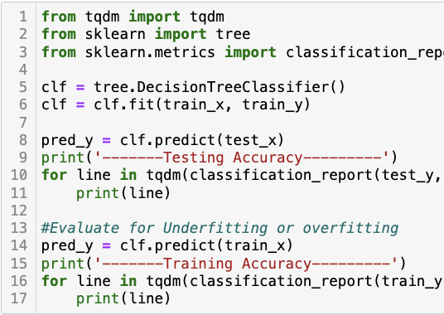
Decision Tree Classifier
Training Accuracy: 100%
Testing Accuracy:
Precision, Recall, and F1-score for both classes: 1.00
Overall accuracy: 100%
Outcome: The model seems to perform exceptionally well on both the training and testing datasets. There is a possibility of overfitting, as the accuracy is very high.

Slide 7
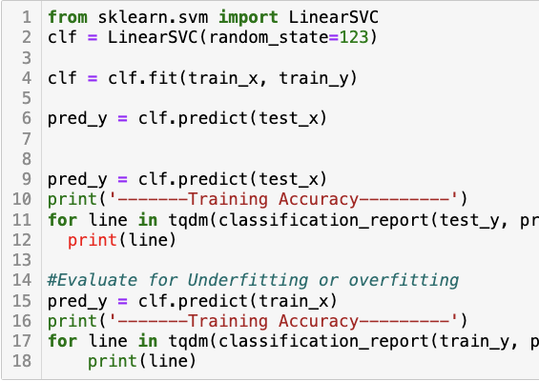
Support Vector Machine Classifier
Training Accuracy: 96%
Testing Accuracy:
Precision, Recall, and F1-score for both classes are around 0.96.
Overall accuracy: 96%
Outcome: The model performs well on both training and testing datasets, and the accuracy is consistent. There is a slight difference between training and testing accuracy, suggesting a good fit.

Slide 8
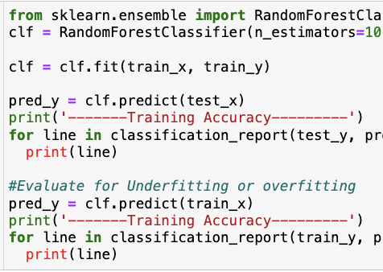
Random Forest Classifier
Training Accuracy: 100%
Testing Accuracy: 100%
Outcome: Similar to the Decision Tree model, the Random Forest model performs very well on both training and testing datasets, indicating a potential risk of overfitting.

Slide 9

Diagnosis of the Models
The models seem to perform well, with high accuracy on both training and testing datasets.
Overfitting is a concern for the Decision Tree and Random Forest models due to their perfect accuracy on the training set.
The Support Vector Machine model appears to be a good fit with balanced performance on training and testing datasets.

Slide 10
Neural Network Model Overview:

Slide 11
Dataset At First Glance:
Dataset Size:
The dataset contains 568,630 entries with 31 columns.
Missing Values:
There are no missing values in the dataset.
Data Types:
The dataset consists mostly of float64 features, two int64 columns (id and Class), and no categorical variables.
Target Distribution:
The target variable 'Class' is binary (0 and 1) and seems balanced, with 284,315 entries for each class.
Duplicates:
No duplicates were found in the dataset.

Slide 12

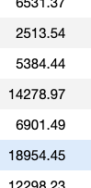
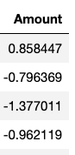
Data Preprocessing:
Scaling:
The 'Amount' feature has been scaled using StandardScaler.
Train-Test Split:
The dataset has been split into training and testing sets with a ratio of 70:30.

Slide 13
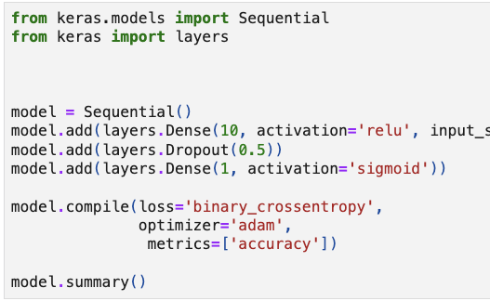
Model Overview
Neural Network Architecture:
The neural network consists of one hidden layer with 10 units, ReLU activation, dropout regularization (dropout rate of 0.5), and an output layer with 1 unit and sigmoid activation for binary classification.
Model Compilation:
Binary crossentropy is used as the loss function, and the Adam optimizer is employed.
Model Training:
The model is trained for 50 epochs with a batch size of 10.

Slide 14
Model Evaluation
Training and Testing Accuracy:
The model achieved a high accuracy of approximately 98.19% on the training set and 98.24% on the testing set.
Precision, Recall, and F1-score:
Precision: 98.38%
Recall: 98.11%
F1-score: 98.25%
Loss Visualization:
Loss and accuracy are visualized over the epochs, showing a good convergence.
Correlation Analysis:
A correlation analysis has been conducted, visualizing the correlation values of each feature with the target variable 'Class'. Features with high positive or negative correlation may have a significant impact on the classification task.

Slide 15
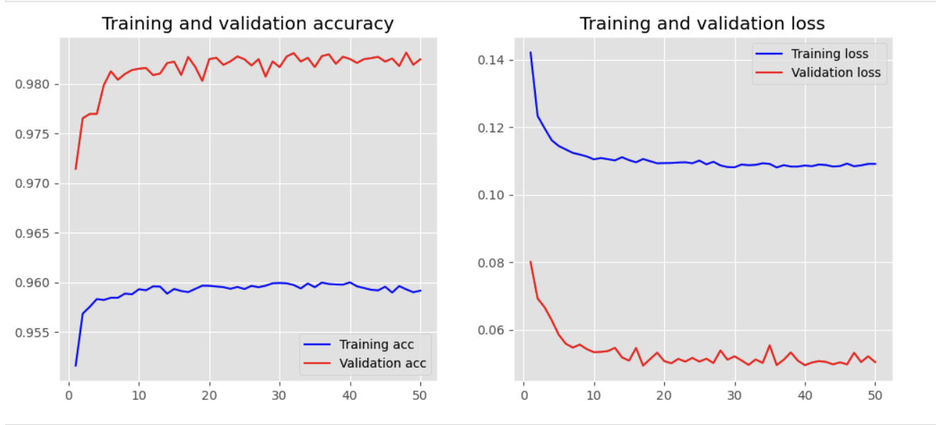

Slide 16
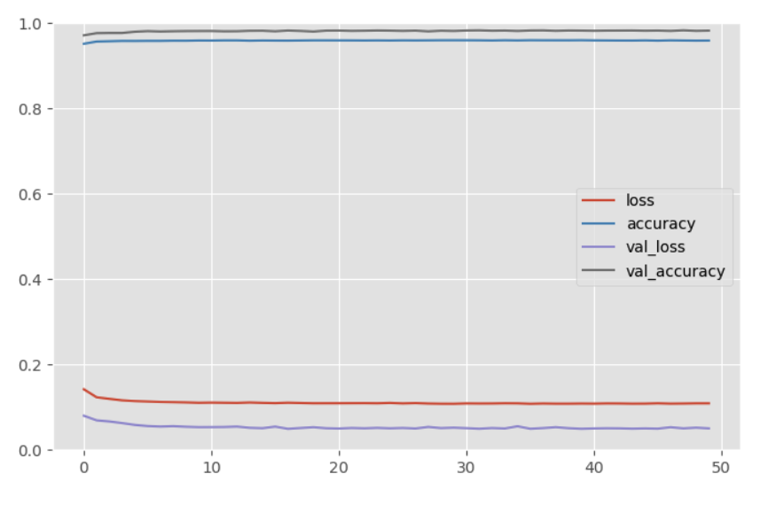

Slide 17
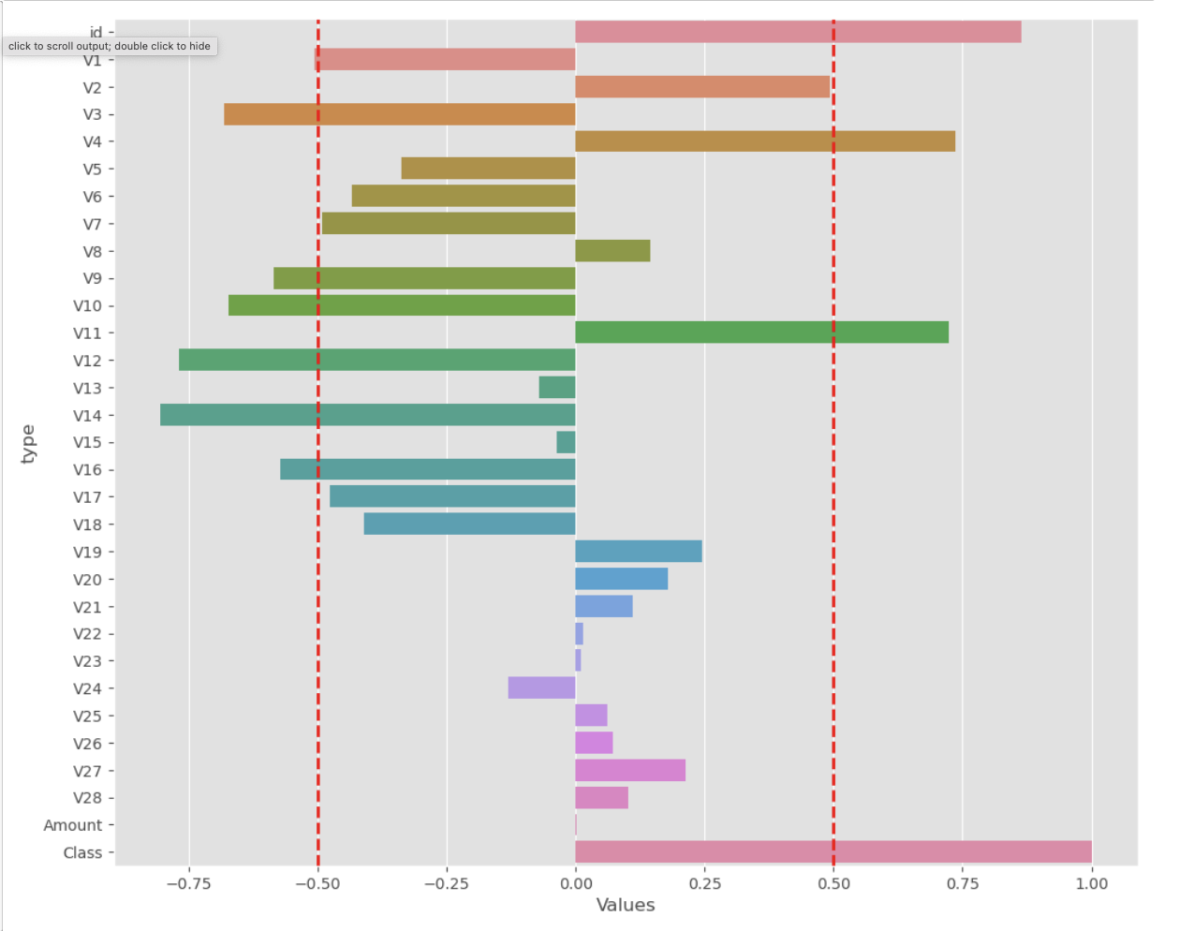
Significant Features
Strong Positive Correlation with Fraud (Class=1):
Variables such as V4, V11, V12, V14, V16, V17, V18, V19, V20, and V21 show a relatively strong positive correlation with fraudulent transactions (Class=1). Among these, V14 and V17 exhibit the highest positive correlations.
Strong Negative Correlation with Fraud (Class=1):
Variables like V3, V9, V10, V12, V14, V16, and V17 have a noticeable negative correlation with fraudulent transactions. Particularly, V3 and V10 show the highest negative correlations.
Amount and Class:
The variable "Amount" has a positive correlation with fraudulent transactions (Class=1). This indicates that fraudulent transactions tend to involve higher amounts.
V28 and Class:
The variable V28 shows a positive correlation with fraudulent transactions (Class=1).
V22 and V23:
V22 and V23 have a negative correlation.

Slide 18
References
Security.org Team. (2023, January 31). 2023 Credit Card Fraud Report. Retrieved from https://www.security.org/digital-safety/credit-card-fraud-report/
U.S. Department of Justice. (2013, February 5). Eighteen People Charged In International, $200 Million Credit Card Fraud Scam. Retrieved from https://www.justice.gov/usao-nj/pr/eighteen-people-charged-international-200-million-credit-card-fraud-scam
Jay, M. (2023, September 12). Inflation is driving up consumer credit card debt by billions of dollars. NBC News. Retrieved from https://www.nbcnews.com/business/consumer/credit-card-debt-rising-as-student-loan-payments-restart-rcna104442
Ohlheiser, A. W. (2023, September 21). Gen Z falls for online scams more than their boomer grandparents do. Vox. Retrieved from https://www.vox.com/technology/23882304/gen-z-vs-boomers-scams-hacks
Obi, O. (2023, September 27). State of Internet Scams 2023. Social Catfish. Retrieved from https://socialcatfish.com/scamfish/state-of-internet-scams-2023/

